Slide 1
Chapter 07
The Java Application Programming Interface
Learn To Program Java
1

Slide 2
Java Application Programming Interface
Java is a programming language that has a very small vocabulary of just 46 reserved words.
To complement the language, Java is designed with an extensible class library known as the Java Application Programming Interface (API).
latest version can be downloaded from http://java.sun.com/docs/index.html.
API is structured in packages.
Learn To Program Java

Slide 3
Package
A class is a modularization of data and methods. By modularization, we mean the grouping of relevant components into a single unit.
Packages are modularization of classes of logically related functionalities.
All classes in Java belong to a package.
By grouping classes into packages, we partition the name space and avoid name clashes.
Learn To Program Java

Slide 4
The package Keyword
A class is qualified as belonging to a package by preceding the package keyword before a class definition.
Package name
package structure;
class Stack {
......
}
The class Stack is said to belong to the package structure, and the complete qualified name for class Stack is structure.Stack. The Java virtual machine maps the package hierarchy onto its directory structure.
Learn To Program Java

Slide 5
A Package
complicated packages such as com.structure.Stack.class, Java will locate Stack.class in com\structure\ directory.
Java requires all classes to be defined in packages.
User-defined classes which are not organized into packages are automatically stored in an anonymous package.
Learn To Program Java

Slide 6
The import Keyword
While the package keyword defines a name space for classes defined in the said package, import makes package constituents visible.
Referring to the class Stack of previous slide, any client (or user) class outside of the package structure must either refer to the class Stack in its qualified
structure.Stack s = new structure.Stack();
or use the import keyword to import the complete name space of the structure package.
Learn To Program Java

Slide 7
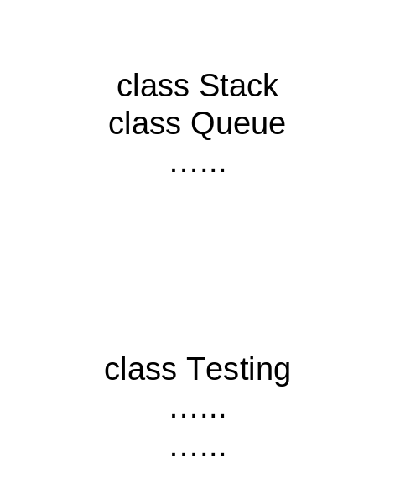
The import Keyword (cont)
package xyz;
class Testing {
……
Stack s1 = new Stack();
// error class Stack does not exist
……
}
package xyz;
class Testing {
……
structure.Stack s1 =
new structure.Stack();
// use full qualified name
}
package xyz;
import structure.*; // entire package
class Testing {
……
Stack s1 = new Stack();
// use import statement
……
}
package xyz;
import structure.Stack; // only Stack
// class
class Testing {
……
Stack s1 = new Stack();
// use import statement
……
}
Stack class must be made public via the keyword public and all methods that are called externally to the class Stack must also be declared public, otherwise, an error will be reported by the Java compiler.
package structure;
class Stack {
……
boolean empty() {……}
boolean full() {……}
void push(int i) {……}
int pop() {……}
……
}
package structure;
public class Stack {
……
public boolean empty() {……}
public boolean full() {……}
public void push(int i) {……}
public int pop() {……}
……
}
Learn To Program Java

Slide 8
The pros of using package
Locate classes
Avoid the conflicts of naming.
Deploy
Protect classes
Learn To Program Java

Slide 9
The J2SE Platform Family
The J2SE platform family consists of the Java 2 Runtime Environment, Standard Edition (JRE) and the Java 2 Software Development Kit, Standard Edition (SDK):
  JRE. Provides the Java Application Programming Interface (API), Java Virtual Machine, and other components necessary to run applets and applications written in the Java programming language.
  Java 2 SDK. It contains the JRE plus tools such as the compilers, or debuggers for developing applets and Java applications.
Learn To Program Java

Slide 10
The Java API
The J2SE API, defines a prescribed interface in which Java programs make requests to use the functionalities of compiled classes in the class libraries which is part of the Java 2 SDK.
The technologies included in the Java API are divided into Core Java and Desktop Java.
  Core Java. Provides essential functionalities for writing powerful programs.
  Desktop Java. Provides a full range of features to help build desktop applications that provide a rich user experience.
Learn To Program Java

Slide 11
Core Java
Database access
  Java Database Connectivity (JDBC)
Security
  Java Authentication and authorization Service (JAAS)
  Java Cryptography Extension (JCE)
  Java Secure Socket Extension(JSSE)
Remote method invocation
  Java Remote Method Invocation (RMI)
Communications
  Java Communications API
  Java Telephony API
  JMX Remote API
Debugging
  Java Platform Debugger Architecture (JPDA)
Documentation
  Javadoc Tool
Learn To Program Java

Slide 12
Desktop Java
Deployment
  Java plug-in
Component modeling
  Java Beans
Graphical User Interface
  Java foundation classes (JFC/Swing) including accessibility, Java 2D, Internationalization API
Multimedia
  Java Sound API
  Java Media Framework (JMF)
  Java 3D API
  Java Advanced Imaging API(JAI)
  Java Speech API
  Java Help System
Learn To Program Java

Slide 13
The Java API Documentation
The Java Application Programming Interface (API) Documentation contains specification information of classes as defined in the Java API class library.
Version 1.4.2 of the Java API can be found at the following URL: http://java.sun.com/j2se/1.4.2/docs/api/index.html
The documentation is organized into Java Packages, with each package containing many classes.
Learn To Program Java

Slide 14
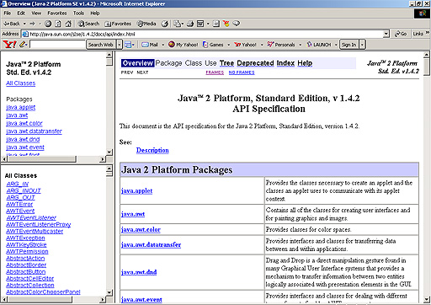
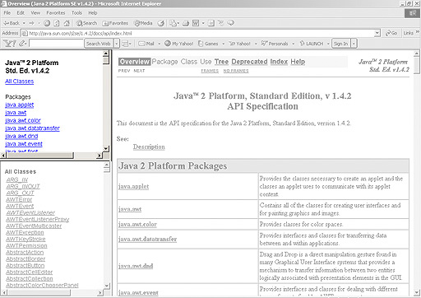
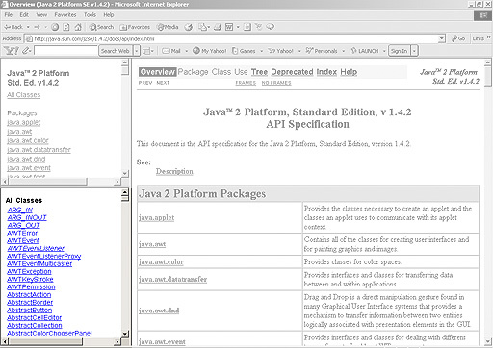
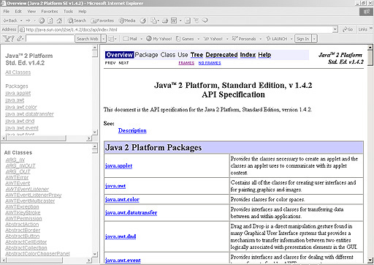
The Java API Documentation (cont)
The documentation is organized into three frames.
The top left frame contains all the Java packages.
We may look for a class based on the package the class belongs to, or by using the index listing of all predefined Java classes in the lower left frame.
The main packages and explains what the packages are defined for.
Learn To Program Java

Slide 15
Directory Structure of Java API Packages
The Java virtual machine maps the package hierarchy onto its directory structure.
Therefore, java.awt and java.awt.color are considered as two separate packages.
Importing java.awt.* does not automatically import classes form java.awt.color package.
java awt (← sub-directory of java) AlphaComposite.class AWTEvent.class AWTEventMulticaster.class … color (← sub-directory of awt) ColorSpace.class ICC_ColorSpace.class ICC_Profile.class …
Learn To Program Java

Slide 16
The java.lang, java.io, and java.util Package
The three packages that are of great interest to any programmers are java.lang, java.io, and java.util.
The java.lang package provides classes that are fundamental to the design of the Java programming language. It is the only package that is automatically imported by Java in any compilation of Java programs.
The java.io package provides classes for system input and output through data streams and files (chapter 8).
The java.util package provides miscellaneous utility classes, including date and time facilities and random number generation.
Learn To Program Java

Slide 17
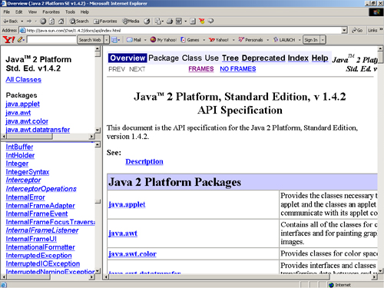
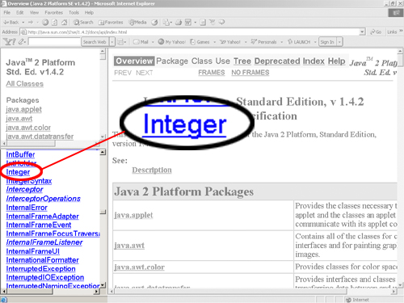
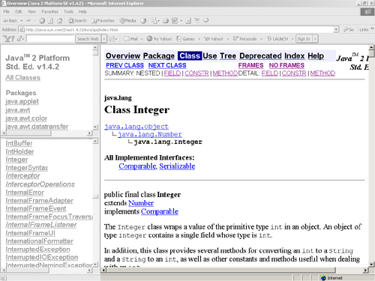
Reading the Java API Documentation
Look up information on the Integer.parseInt().
First find the documentation on the Class Integer.
One way is to simply look at the frame on the bottom left marked “All Classes”.
Clicking on the Class Integer brings up the documentation in the right frame.
Learn To Program Java

Slide 18
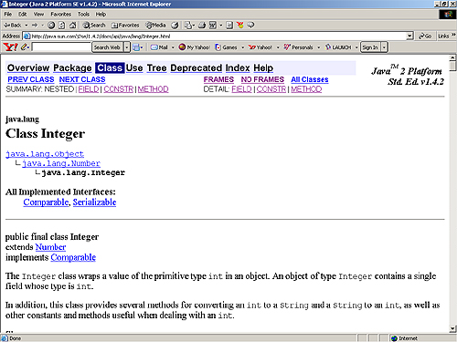
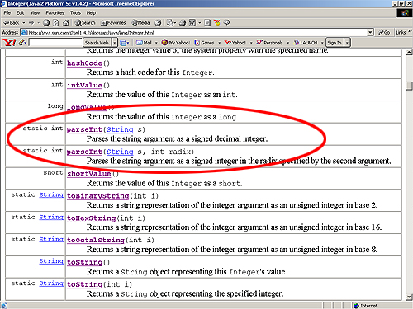
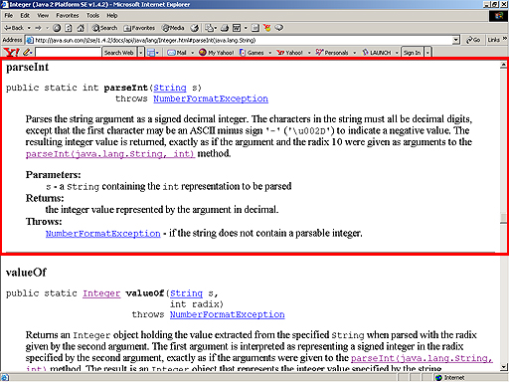
Reading the Java API Documentation
The right frame shows a short description of the class Integer.
Scrolling down to the Method Summary, we find the method:
static int parseInt(String s)
Clicking on the word parseInt gives us the full description of the method.
Learn To Program Java

Slide 19
Using the Java API
The Java API can be used in 3 ways:
  By creating an instance of a Java API class.
  Example: Date d = new Date();
  By creating a new class that is a subclass of a class in the API via the inheritance mechanism.
  Example: public class myApplet extends Applet {…}
  By using class variables that have been defined in API classes.
  Example: System.out.println()
  The class variable out in the System class may be used directly for the purpose of printing to the standard output stream.
Learn To Program Java

Slide 20
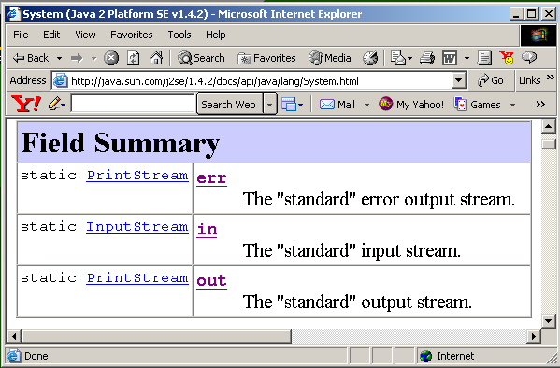
Ubiquitous System.out.println Method
Begin by locating the System class in the API.
There are three predefined fields in the Field Summary section.
in represents the input stream, out represents the output stream and err represents an alternative output stream for error messages.
Notice out has been defined as a PrintStream object in clicking on PrintStream, we locate the println methods.
There are 10 println methods have the same name indicates that println is overloaded.
Learn To Program Java

Slide 21
System.out.println Method
The 10 println() methods are distinguished by the number and types of parameters that accompanying the println methods.
Thus, any PrintStream object is capable of printing Boolean, character, character array, double, float, integer, long, Object, and String values.
A blank line can also be printed by using println().
All println methods append a carriage return after the value.
Learn To Program Java

Slide 22
PrintStream Class
println()
println(boolean x)
println(char x)
println(char[] x)
println(double x)
println(float x)
println(int x)
println(long x)
println(Object x)
println(String x)
Learn To Program Java

Slide 23
String Tokenizers
Tan Ah meng;12345:;98.7
java.util.StringTokenizer Class
boolean hasMoreTokens()
String nextToken()
import java.util.*; Class StringTokenizerTest{ public static void main(String[] args){ String s =args[0]; String delim= args[1]; StringTokenizer st=new StringTokenizer(s, delim); while (st.hasMoreTokens()) System.out.println(st.nextToken()); } }

Slide 24
Summary
Classes are grouped together into packages for better management of classes.
A package is defined as a modularization of classes of logically related functionalities.
It is identified in Java via the package keyword.
The import keyword is used jointly with packages to make package constituents visible.
The Java API is a library of classes organized in packages.
Documentation on how predefined Java classes can be used is recorded in the Java API. It is an essential library that all Java programmers must learn to use.
Learn To Program Java

Slide 25
Summary
The java.lang, java.io, and java.util packages are the three most commonly used packages.
The java.lang package provides classes that are fundamental to the design of the Java programming language.
The java.lang package is the only package that is automatically imported by Java in any compilation of Java programs.
The java.io package provides classes for system input and output through data streams and files.
The java.util package provides miscellaneous utility classes, including date and time facilities and random number generation.
Learn To Program Java

